Slide 1

Exiting your Comfort Zone: 10 Office 365 Tips To Rock Your World
@TechKnowFile #TKF18 Marden Paul, ITS

Slide 2

My Mission Today: To share 10 Office 365 tips that you can take back to your office to do your work a bit differently … and to rock your world... wherever that may be.

Slide 3
New World of Capabilities at U of T
Forms & Surveys
AD to EAD
Centrex to VoIP
Skype 4
Business
Portal to Quercus
ROSI to ACORN
On-Demand
Meetings
Exchange to Office 365
True Blue
OneDrive Sharepoint
Document Sharing
Stream
Teams
Rights Mgmt
Notes:
All kinds of new services with new ways to operate are coming online. We are committed to providing the education and awareness so that you can take full advantage of the opportunities afforded by these services – but we need to help you make the leap to some new places.

Slide 4
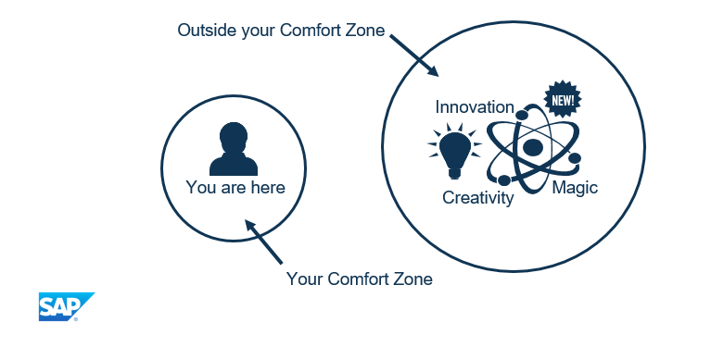
Notes:
I found a slide, from SAP no less, that makes the point. Like learning a new function – my stress always comes when I try to set up autolookup tables in Excel – once its tried and mastered, it becomes natural. Earlier in the week I sat with a number of colleagues from my team and EASI to learn about AMS/ROSI printing. There’s a unix editor, funny looking commands, and it’s a topic of great mystery. But, once learned, and practiced a lot more, this won’t be so hard and we will have mastered something we didn’t want to know much about before.

Slide 5


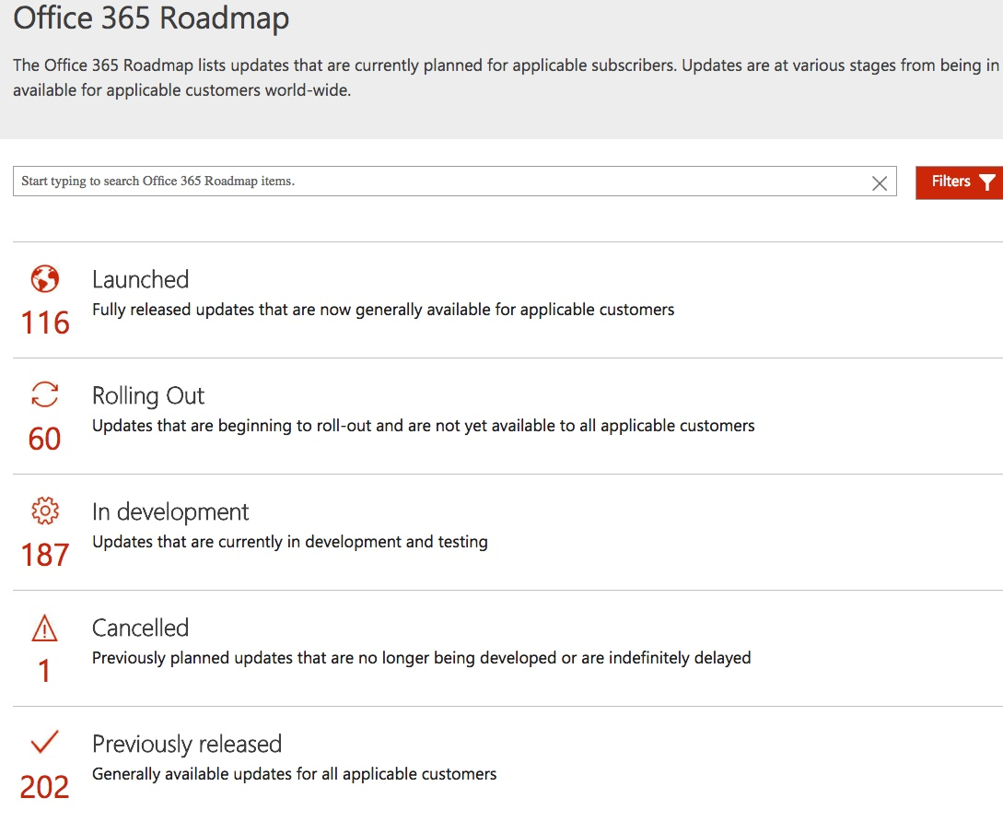

Office 365’s Quantum Reality
Notes:
There’s another comfort zone requirement with Office 365 – you can’t get too comfortable with what is…this is a good thing … functions will pop up sometimes – like new services from the Microsoft Garage or from the Roadmap or Dr. Who. And sometimes they’ll disappear.

Slide 6
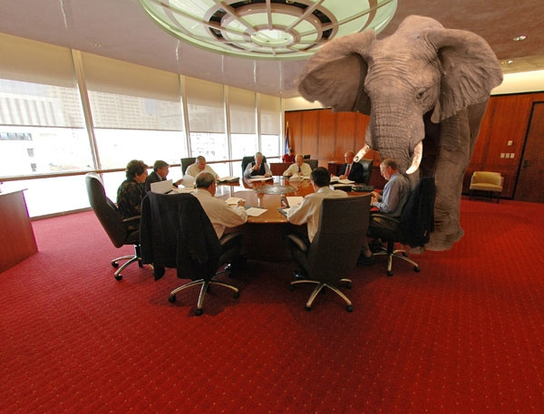
Important things to remember
Regular change
New functionality
We want u 2 experiment
We want to know what you do
We want to share great practices across the University
You are the experts!
Watch the monthly updates, the Office 365 Roadmap, and http://office.utoronto.ca

Slide 7
For each of today’s functions, we’ll consider…
What does it do
Why it’s useful
How to use

Slide 8
10+ World-Rocking Office 365 Functions
Undo Send
Sweep
Pinning
Saving attachments so you can find them
Not sending yourself a document in an e-mail
Working on a document online
Sharing a document
Document collaboration
Rights Management and Information Protection
Recording a Skype for Business Meeting
Suggest Meeting Times
Team
Notes:
Some you may know about, others not…

Slide 9
Where We Are
Functions Released
Outlook e-mail and Calendar
OneDrive
Skype for Business
Office Online
Piloting
Teams
Sharepoint Online
Stream
Forms and Surveys
Under Investigation
Multi-factor Authentication
Rights Management
Azure Advanced Threat Protection
Enterprise Mobility and Security
Intune
Data Loss Protection
Office 365 Message Encryption

Slide 10

OUTLOOK EXCITEMENT
Undo Send
Sweep
Pinning
Attachments
Bahen Centre, University of Toronto

Slide 11

Outlook Excitement
Provides a window for up to 30 seconds before an e-mail is delivered
Good for those…
Oh no, reply all!!!
Oh oh! Didn’t mean to say that
Wrong person
30 seconds is the max
#1 UNDO SEND
https://www.absoluteperfectionmedia.com/unsend-gmail/

Slide 12
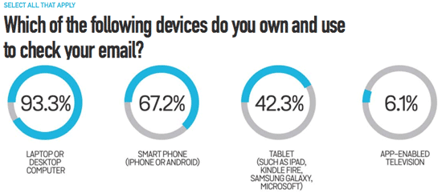

Outlook Excitement!
For the infinite marketing ads, Starbucks offers, online trade magazines, facebook alerts…
Select the SENDER
Press SWEEP
Apply a rule
#2 SWEEP
https://www.emailmonday.com/mobile-email-usage-statistics
Notes:
There are a lot of ways to check your email. Lots of polls and studies, but let’s say upwards of 10 times per day. How to separate the wheat from the chaff

Slide 13

Outlook Excitement
#3 PINNING
Message of importance arrives in Inbox
You heading out to meeting
Where did the message go? Who sent it?
Where’s that important attachment?

Slide 14
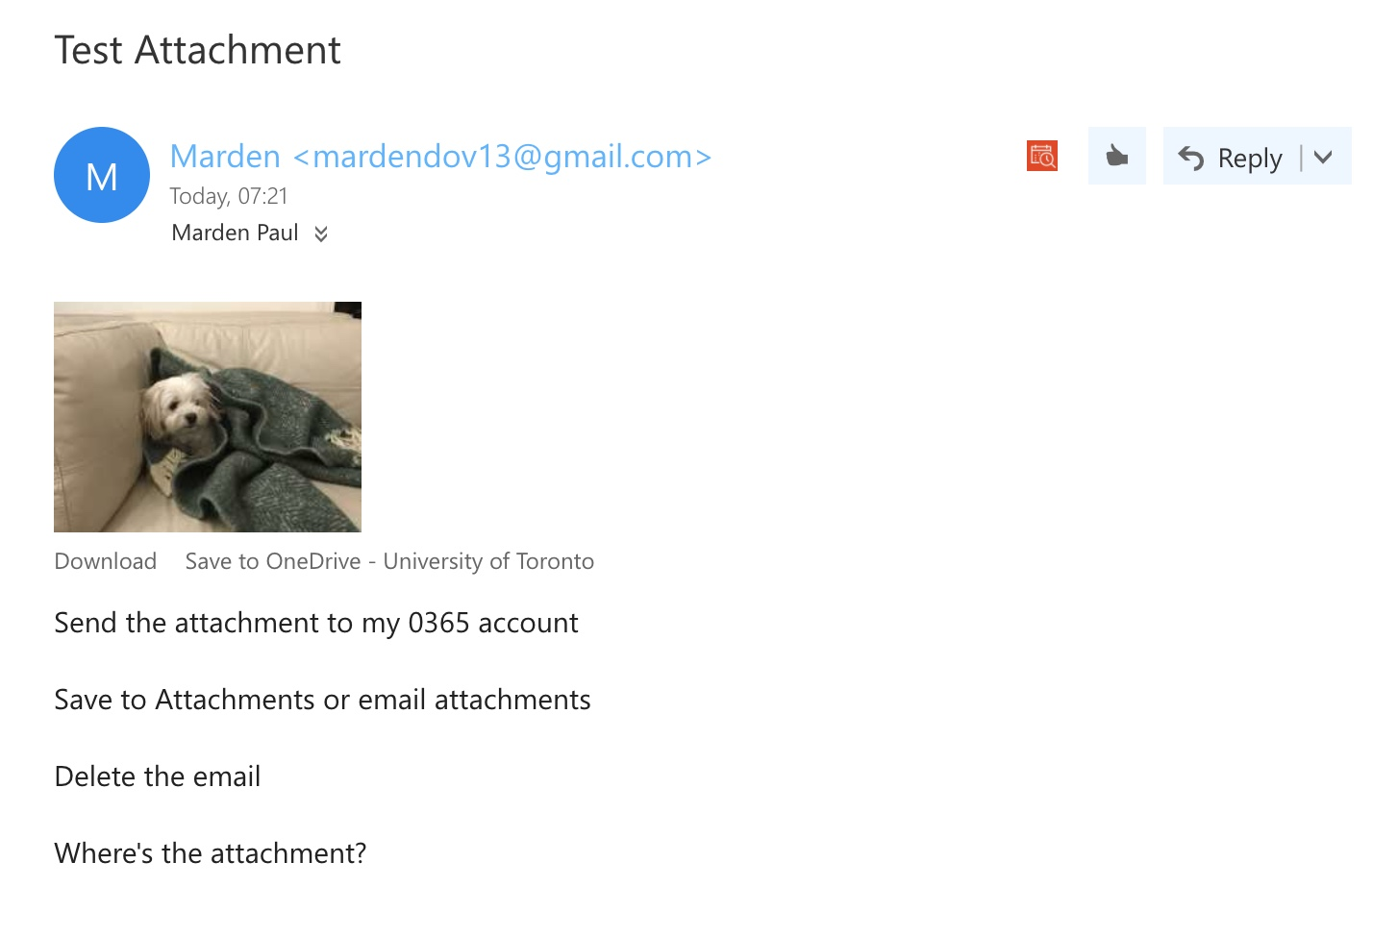
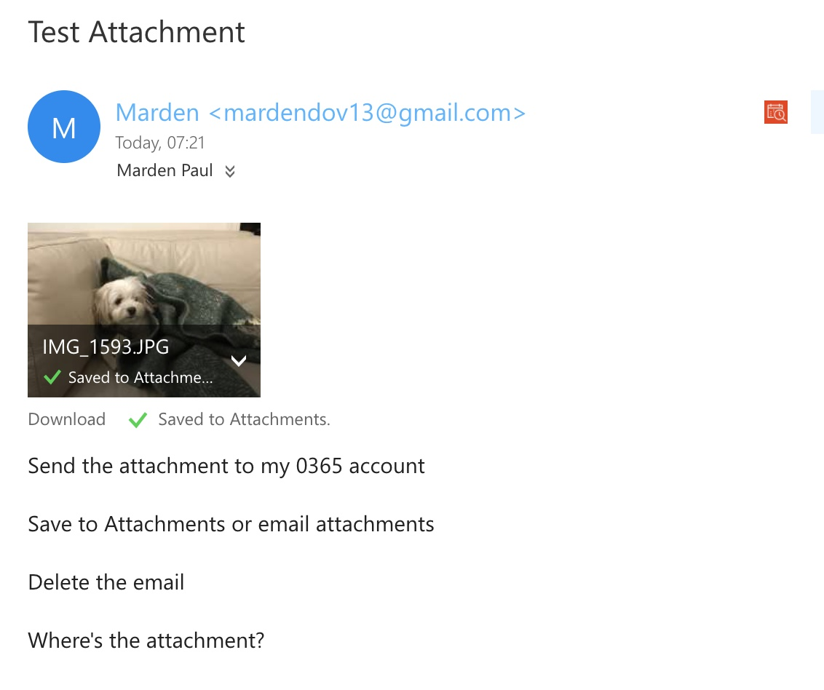
#4 Saving Attachments so you can find them
Outlook Excitement

Slide 15
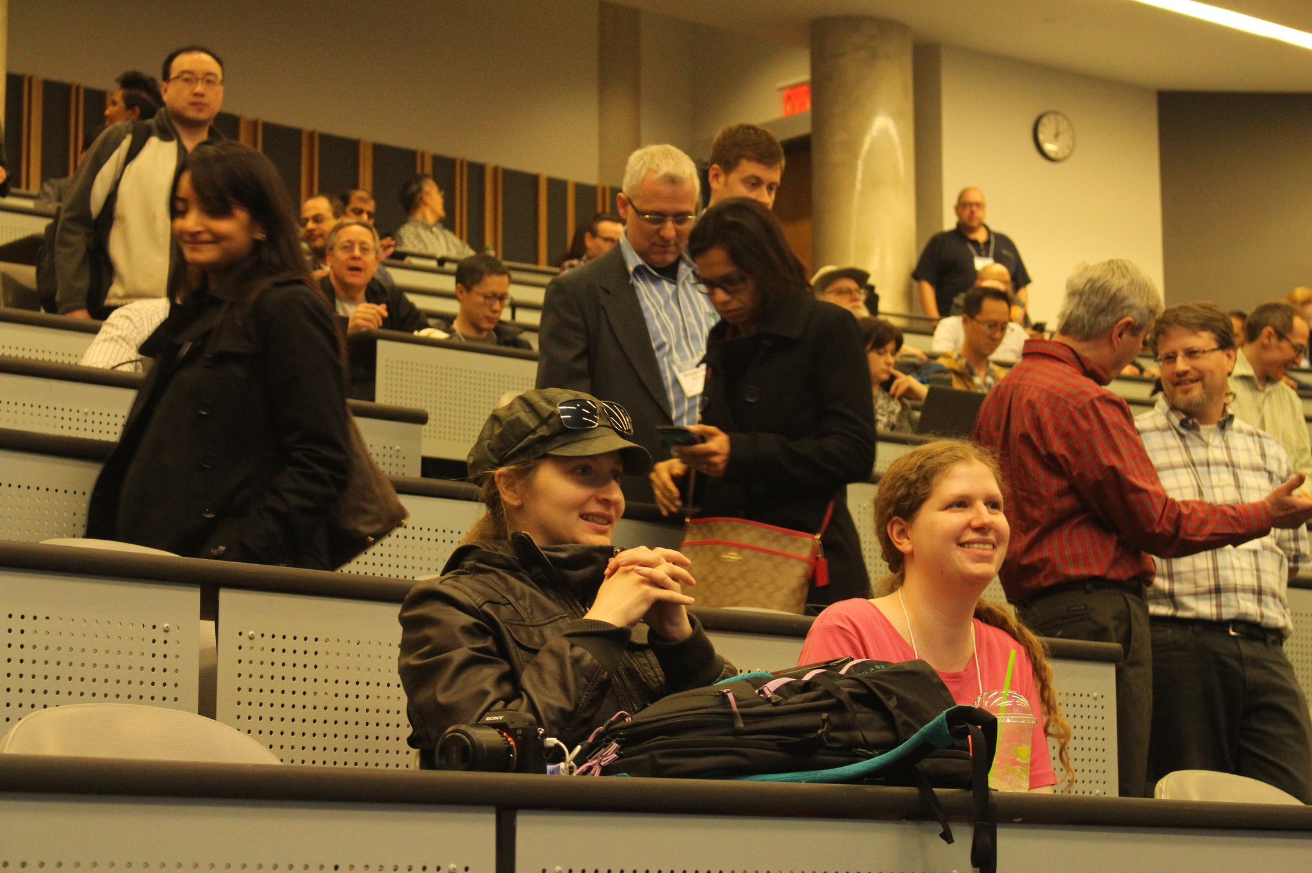
OneDrive -- Many Uses
4. Not sending yourself a document in an e-mail
5. Working on a document online
6. Sharing a document
7. Document collaboration
Scenes from #TKF17 | Photo: Russell Sutherland

Slide 16
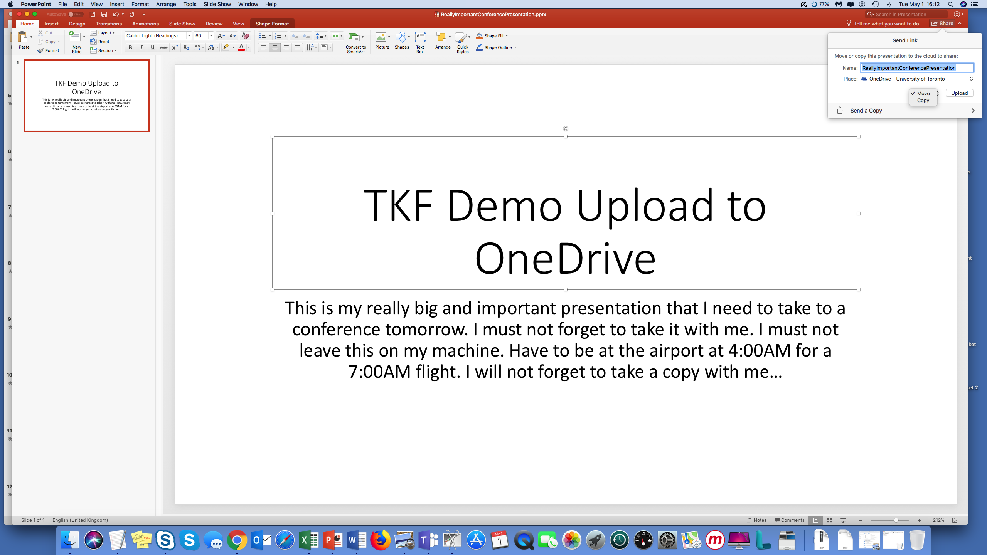
# 5 Not Sending Yourself a Document in an e-mail
Working on a presentation
I’m tired and want to go home
Will finish it later
What to do?
Attach to e-mail?
Too big?
Send to Dropbox????
Put on memory stick?
Can’t find memory stick
Gum in the port
Notes:
- Demo: Working on the document. Click the SHARE. CHOOSE whether to COPY or MOVE. Document now on OneDrive. Easy to access at home. No need to worry about version.

Slide 17
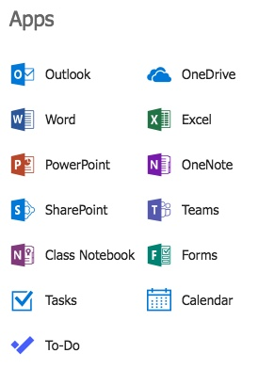
#6 Working on a Document Online
Office 365 includes online versions of Office software
Why to use?
Quickly create or edit a document anywhere
Easy to share
Use when you don’t have access to your PC
Useful if you forget your presentation at home
Notes:
Go to Onedrive and open a document. Show the edits. Oep=

Slide 18
#7 Sharing a Document
How do we do share today?
For comments, review, edits, collaboration
Print copies and markup
E-mail copies and edit with tracked changes
Use Google Docs to co-edit…

Slide 19

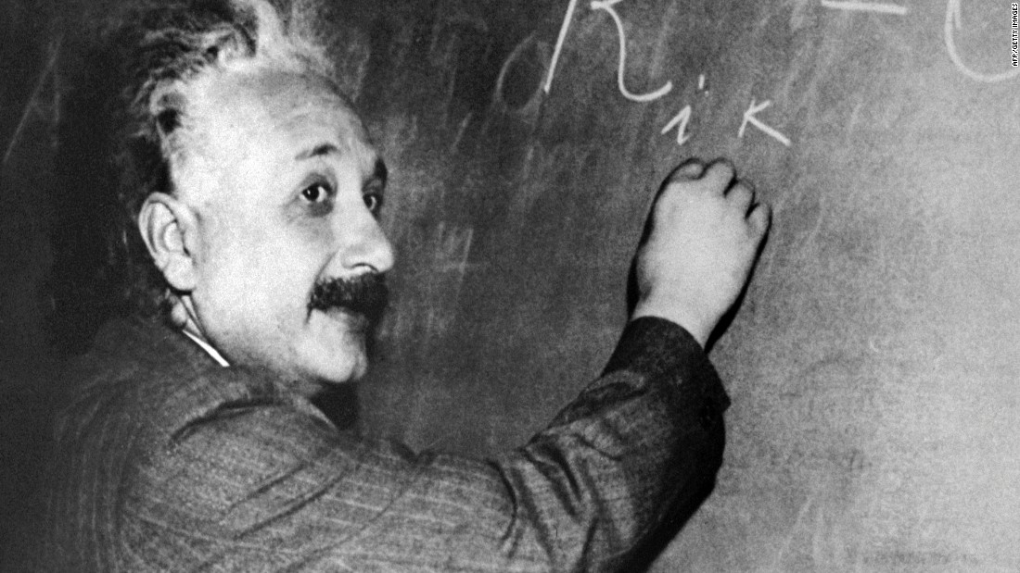
What happens when you send a document to 5 people in e-mail?
COPY
Email to 5 others
Download to PCs
Edit Document and Return to Sender
How many copies?

Slide 20
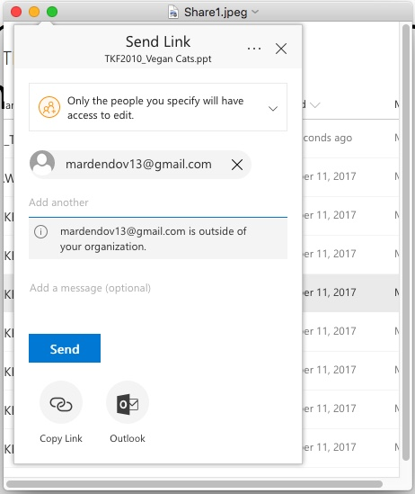
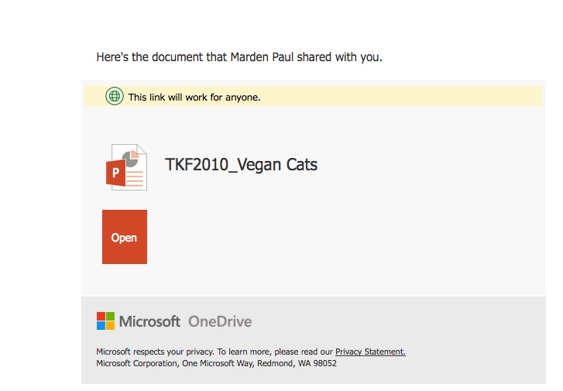
Sharing in Office 365
Select the file to be shared
Decide with whom the sharing will occur
Enter their addresses
Send the message with the LINK
Notes:
Value of the LINK – the document is still safely in one place. DEMO: Show the link. Open the document. Go back to OneDrive and show VIEWS, document properties. Sharing. Versions.

Slide 21
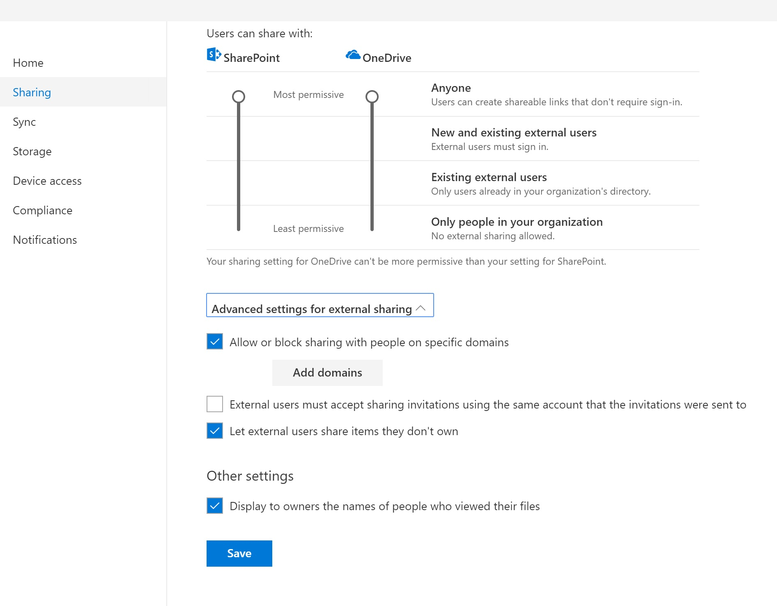
OneDrive Sharing Controls

Slide 22
# 8 – Document Collaboration
Sharing with one or more people
Turn Track Changes on in the client version
Co-editing simultaneously is possible
Versions are captures
Links are sent, not documents
Links can be time-specific
Links can be controlled
Notes:
DEMO: Open OneDrive Guidance; see VIEWS, see document properties; view comments; show versions and how to restore

Slide 23



#TKF18
@TechKnowFile
Really Exciting
9. Rights Management
10. On-Demand Meeting
11. Teams
12. Suggest Meeting
Notes:
Potp

Slide 24
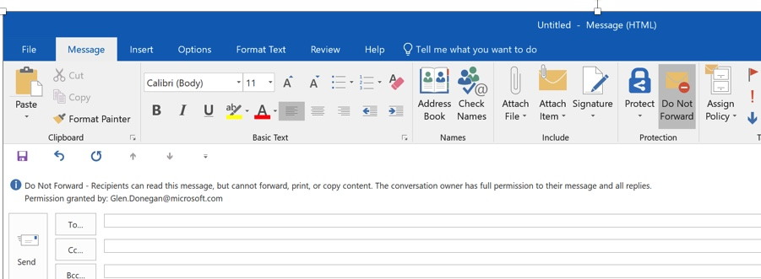
# 9 – E-mail Protections – Do Not Forward
Ned.squirrel@utoronto.can

Slide 25
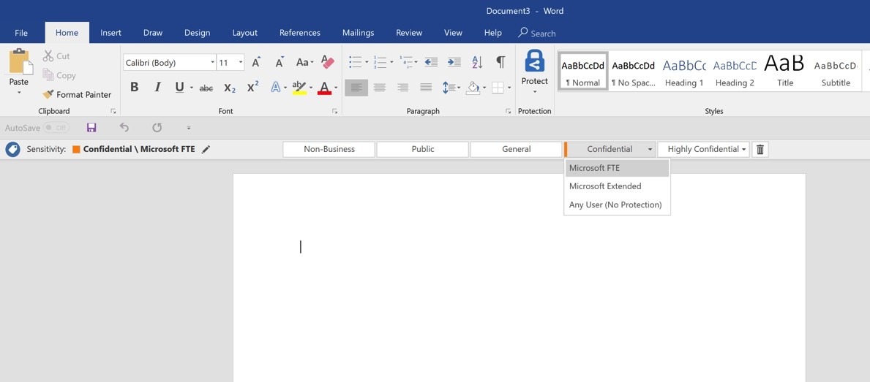
# 9 – Protected Classified Word Document
UofT FTE
UofT FTE
UofT Extended

Slide 26
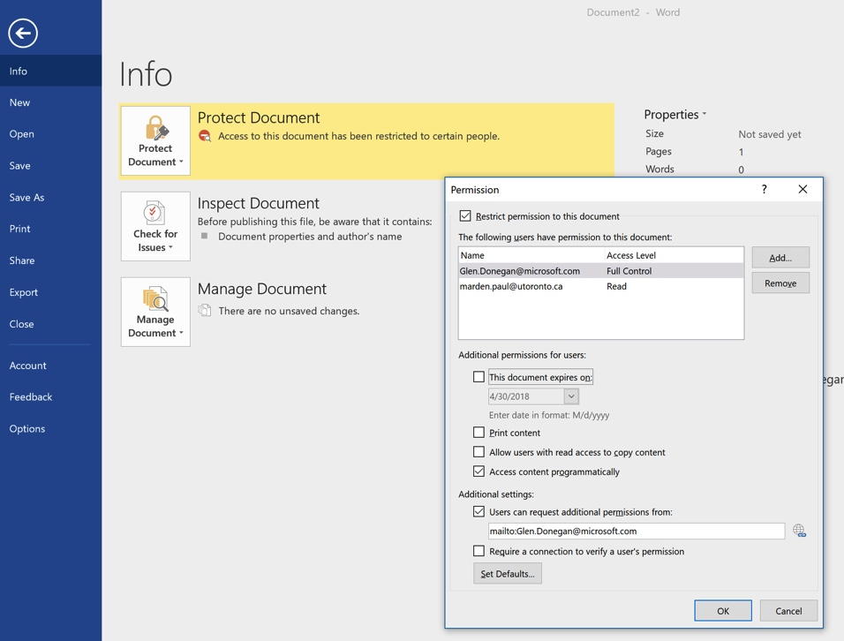
#9 – Document Protection Panel
WHO
ned.squirrel@utoronto.ca
EXPIRY
RIGHTS
OWNER
Grey.squirrel@utoronto.ca

Slide 27
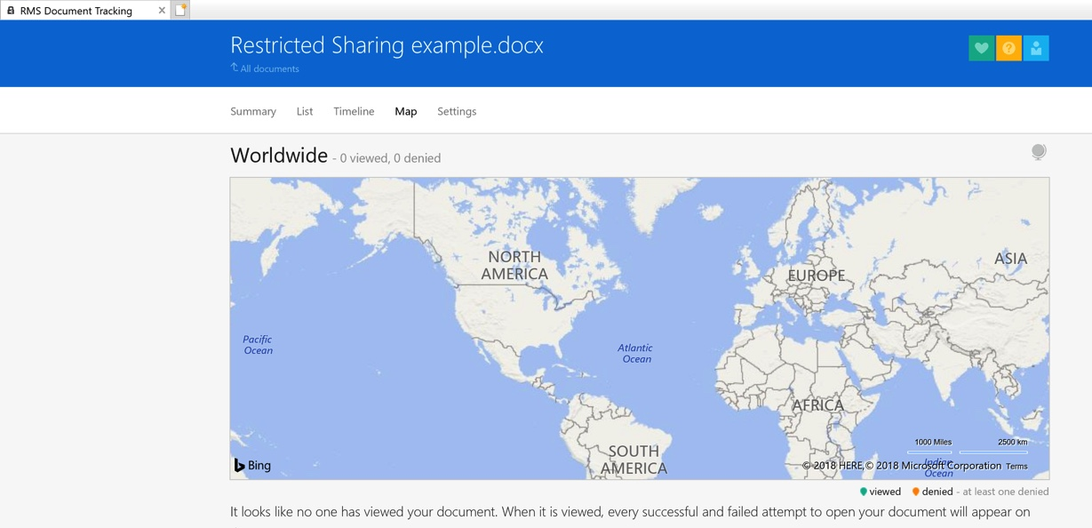
#9 – Restricted File Viewing

Slide 28
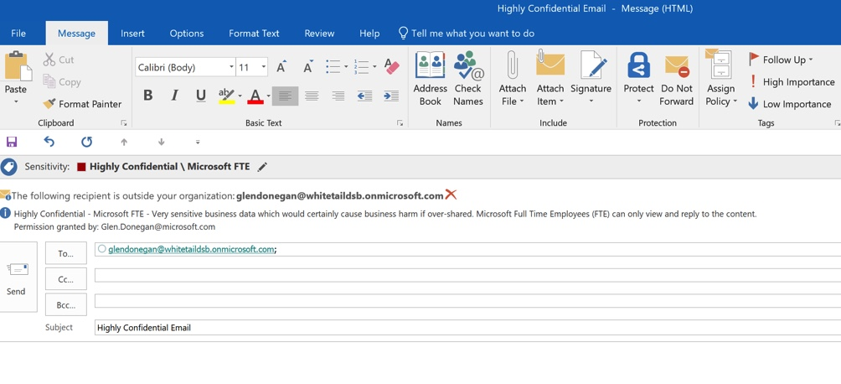
#9 – Highly Confidential E-mail
University of Toronto
Ned.squirrel@oakmail.comn
UofT FTE Only
a.maize@utoronto.can
Ned.squirrel@oakmail.comn
Notes:
Key for all these is Azure Information Protection

Slide 29
Information Protection Key Elements
Set data classification on e-mail and documents with ribbon
Setting classification type establishes controls on documents such as:
Will not forward
Will not print
Will not download
No copy and paste allowed
Depending on the service type implemented, rules may be manually or automatically applied
Ability to add digital signatures
Rights Management establishes control such that, for example, a person without a Faculty role would not be able to open or read a document or e-mail
Multi-factor authentication requirement, applied with granularity
Notes:
We are investigating how to implement, and which licesnses are applicable.

Slide 30
#10 – Recording a Skype for Business Event
Members of the team could not attend
It’s a training workshop that can now be replayed
Project activities can be documented this way – chats, whiteboard flow, files, conversations…

Slide 31
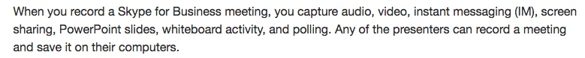
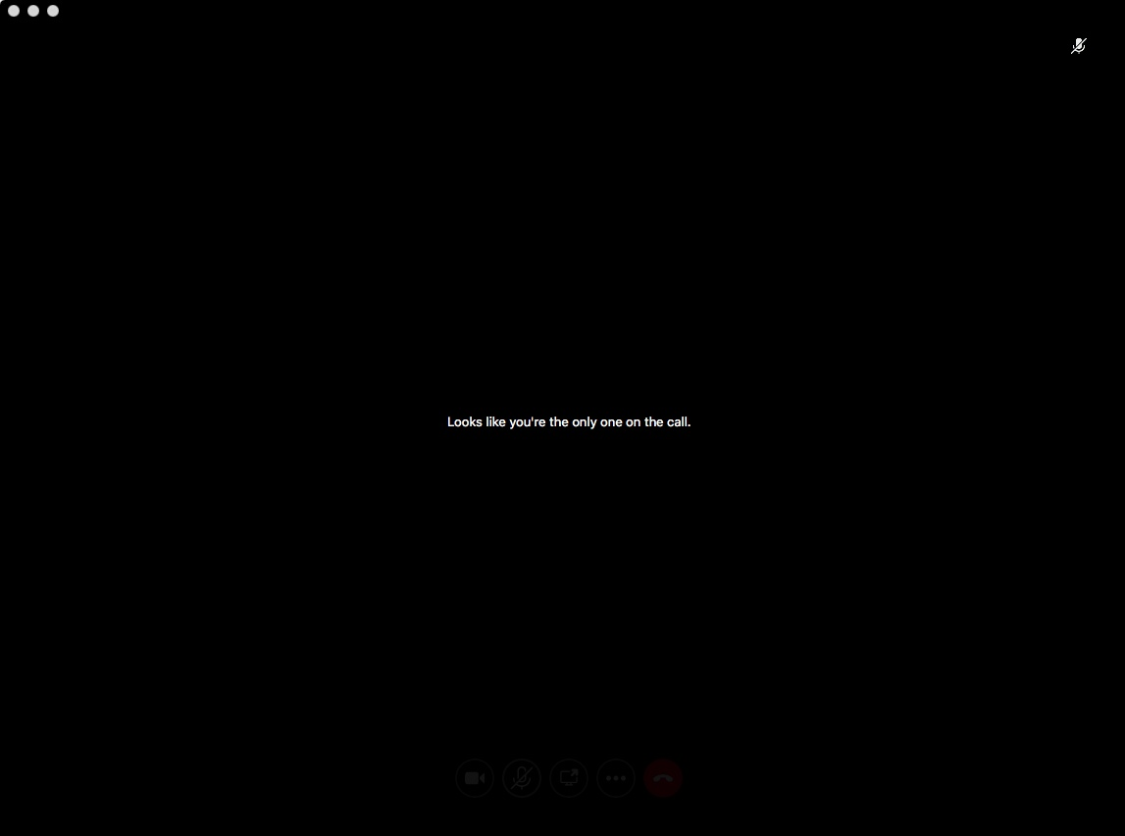
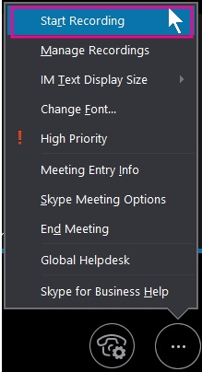

How

Slide 32
#11 – Teams and OnDemand Meeting
A place for teams to chat, share files, have calls and meetings
Teams rolling out with focus on migrating from Blackboard Organisations before September 2018
Relatively new utility so functions still appearing
We will be continuing to roll out from CTSI and O365 HQ, but will delegate to departments when naming convention utility, persistence controls are released.

Slide 33
Thank You!
How to reach me,
… or to invite me to visit your department…
Marden Paul
marden.paul@utoronto.ca
Skype 4 Business
416 946 0440 or 416 578 0615
Twitter: mardster

Slide 34
Thank You
@TechKnowFile #TKF18

